Slide 1
Unit 1

Slide 2
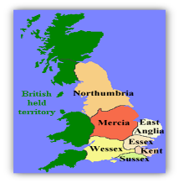
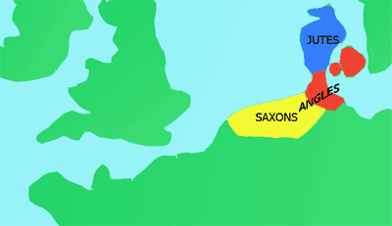
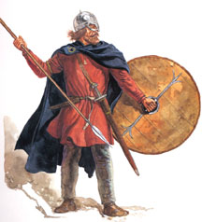
Anglo-Saxon Society: England before 1066
This topic focusses on the arrival of the Normans but you need to know about Change and Continuity and so you need to know about Angl0-Saxon society before.
What do I need to know:
What England was like before 1066..
The importance of the Godwin Family.
So what was life like in Anglo-Saxon England?
Around two million inhabitants
Life was hard
Life expectancy low
Most people farmed the land
At the top of Anglo – Saxon society were the aristocracy (people who had wealth and power), in the middle the peasant farmers and at the bottom the slaves
Religion was an important feature of society
King Edward the Confessor had ruled since 1042
Key Words:
Earl
Exiled
Housecarl
Inherit
minting
Where did the Anglo-Saxons come from?
The Anglo-Saxons came from Denmark, Germany and the Netherlands.
These fearsome warriors rowed across the
North Sea in wooden boats to England and forced the tribes in Britain to flee their homes.
Within a few centuries, the land they had invaded was known as England, after the Angles.
Who were the Anglo-Saxons?
Believe it or not, the Anglo-Saxons were warrior-farmers. They began to invade Britain while the Romans were still in control.
They wanted control and land.
The Anglo-Saxons were tall, fair-haired men, armed with swords and spears and round shields.
Their other skills consisted of hunting, farming, textile (cloth) production and leather working.
There were three groups of people who settled in Britain which together, are called the Anglo-Saxons.
These three groups are called:
Jutes
Angles
Saxons
The Angles and the Saxon tribes were the largest of the three attacking tribes and so we often know them as Anglo-Saxons.
For about 150 years the Britons fought the Anglo-Saxons, but by the year 600 the Britons had either been forced to flee to Wales or the West Country and had become slaves.
By the year 600 Britain had been divided into 7 main Ango-Saxon Kingdoms:
Northumbria, Mercia, Essex, East Anglia, Wessex, Kent and Sussex.

Slide 3
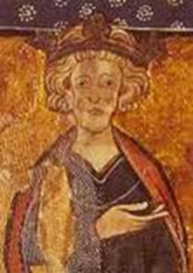
Anglo-Saxon Society: Edward the Confessor and the Godwin family
What do I need to know:
Who the Godwin’s are
How successful Edward the Confessor rule was.
King Edward the Confessor’s Rule:
Ruled since 1042
Before 1042, England had been ruled by Edward’s half brother, Harthacnut
His reign had been stable and largely peaceful, there was a growing threat from Normandy and Norway / Denmark
The earls were the most important aristocrats, the relationship with the king was based on loyalty
King Edward was not a warrior king he relied on his earls being a powerful military force, especially Earl Godwin
During his time he brought many of his Norman friends to England as advisors
This angered the Anglo – Saxons and caused some disagreement with Earl Godwin
King Edward was a respected law – maker and he was very religious
King Edward was married to Edith of Wessex, Earl Godwin’s daughter
Key Words:
Earl
Exiled
Housecarl
Inherit
minting
Who were the Godwins and why were they important?
The Godwins were a powerful ruling family in England
Earl Godwin (1001 – 53) was born in Wessex
Anglo - Saxons
Godwin and King Edward had a major dispute when Godwin refused to follow the king’s orders, Godwin was exiled by the King
Godwin returned with his army BUT King Edward was unable to raise an army, Godwin was stronger
The king reinstated Godwin, the earls, their lands and their power = the power of the Godwins increased
Earl Godwin died 1053 and his son Harold Godwinson becomes Earl of Wessex
By the mid 1060s the Godwins had control of most of England and advised the king
When Edward the Confessor died on the 5th January 1066 he had no children. As a result , it was unclear who was to become King. After Edward’s death there were many powerful men who put forward their claim to the throne, four of whom presented the strongest claims. However, the claimants came from different countries and had differing levels of support.

Slide 4
The rival Claimants
What do I need to know:
to reasons for their claims to the throne.
Strengths and weaknesses of claims.
Key Words:
Aethling
Bayeux Tapestry
Sub-regulus
Novissima verba
Post obitum
Witan
In 1066, Edward was seriously ill but a succession crisis was just around the corner. There were 4 men who believed they had a right to be the next king of England. Edward was 62 when he died but had no heir.
Edgar the Outlaw
(Aethling)
(c1051-1126)
The nearest relative and the great nephew.
Only 14 years old.
He had no money, no soldiers and no military experiences.
His grandfather, Edmund Ironside, was Edward’s half-brother.
Edmunds son, Edward the Exile had been named as successor by Edward the Confessor in 1056.
But he had died after his return to England in 1057.
Edgar and his sister had lived with Edward and his wife Edith, since they were small children.
Edgar was an Anglo-Saxon had the support of many earls.
Harald Hardrada: The Viking Warrior.
(c1015-1066)
Harald was the King of Norway and had ruled for 20 years.
He was a seasoned warrior
He was the leader of the famous Varangian Guard
His name means ‘hard ruler.’
He had the support of Harold Godwinson's brother Tostig.
Tostig flattered Hardrada and offered him the support of the north of England.
Many people in the North were Scandinavian and so felt they should support him
He was a powerful Viking with a large and successful army.
He was related to King Cnut who reigned from 1016 to 1035.
His claim was that, as Edward had no sons a relative of the previous king should be chosen.
It was said that Hardrada’s father Magnus had been promised the throne by Cnut’s son, Harthacnut.
Edward had claimed the throne, throwing Hardrada aside.
Harald Godwinson: (c1022-1066)
He was the most important earl n England as the EARL OF WESSEX.
He was not a blood relation but he was the King’s brother in law as he was married to his sister Edith.
The Godwins had tried and failed to overthrow Edward in 1051.
They were exiled but dominated the Witan so they were allowed to return to England just a year later.
Harold inherited his father’s earldom in 1053.
He was the richest man in England.
He was a skilful military leader.
He was the Sub-regulus’ a deputy king who ran England for Edward and represented him in battle from 1060 onwards.
Harold said that Edward had promised him the throne on his deathbed
He had the support of the Witan.
He had support of the English Nobles.
William of Normandy alleged that Harold had earlier sworn him a sacred oath of fealty to support his own claim to the throne.
Harold did not deny making the oath but he said he only swore it as he was a prisoner by William and his life was threatened so it wasn’t binding.
William, Duke of Normandy.
(c1028-1087)
William took over as Duke of Normandy at the age of 7 and faced many attempts against his life in this position.
William was a successful and brutal warrior.
In 1047, William and his army won the battle of Val-es-Dunes and cut off the heads and feet of his enemies after they made a comment about his mother.
He was a distant cousin of Edward through Edward’s mother, Emma.
William claimed that Edward had promised him the throne earlier in his reign.
In 1051, the Godwins rebelled against Edward, and William travelled to England to give his support to Edward and as a result Edward promised him the throne.
William said Harold Godwinson had sworn to support his claim to the throne in 1064.
Wessex and Normandy had been allies since 988. They were natural trading partners and helped each other when facing threats such as the Vikings.
This relationship had the blessing of the Pope.
William had proved himself a capable ruler of Normandy and hoped to expand his power into England.
The Succession Crisis in 1066:
England had a troubled history in the 50 years leading up to the succession crisis of 1066.
There were no clear rules in place for succession to the English throne.
Edward the Confessor had been a weak ruler. He increased Norman influence at court and allowed the Godwin’s to increase their power.
Harold was hurriedly crowned just one day after Edward’s death. The haste reflected how insecure he felt. He knew he would face challenges form the other claimants.

Slide 5
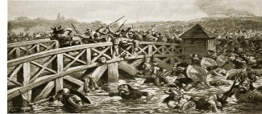
Harald Hardrada invades
What happened when Edward the Confessor died?
5th January 1066 – Edward the Confessor dies
6th January 1066 – Harold Godwinson crowned King of England
What happened to the 4 contenders?
William, Duke of Normandy claims the throne was promised to him – he mobilises his troops in preparation for an invasion of Britain
Edgar Aethling considered too young to be King or challenge the decision
Harald Hardrada prepares to invade in the North
8th September – peasant soldiers, known as the fyrd, sent home to harvest the crops
Harald Hardrada invades the north of England
Earls Edwin and Morcar wait with the northern army to prevent the Norwegian forces from advancing
What do I need to know:
The events of the Battles of Fulford Gate and Stamford Bridge
Why Hardrada won Fulford
Why he lost Stamford Bridge.
From the moment that Harold Godwinson was crowned, he was aware that he faced a number of challenges to his throne. He marched south which part of his army to prepare for an invasion by William. He left the rest of his army under the command of his brothers in law earls Edwin and Morcar.
Key Words:
Fulford gate
Fyrd
Hardrada
Stamford Bridge
Viking
Harold prepares to strike!
Haralf Hardrada of Norway invaded England in the September.
He sailed up the river Humber with 300 ships and landed 16 km (10 miles) from the city of York. Earls Edwin and Morcar were waiting for him with the northern army and attempted to prevent the Norwegian forces from advancing to York.
The Battle of Stamford Bridge
Were the battles significant?
Significant because… | However…
Hardrada and Tostig’s invasion meant that Harold was not in place to prevent William’s invasion. | Harold had already sent the peasant soldiers (fyrd) home.
Edwin and Morcar made errors that meant the loss of thousands of men at Fulford Gate. | Harold was already on his way to support the northern army that suggests he did not think that Edwin and Morcar could defeat the Vikings.
Edwin and Morcar survived Fulford Gate, but they were unable or did not want to fight in further battles. | There is limited evidence to support this from the next battle.
Harold’s success at taking the Vikings by surprise might have made him overconfident. | Harold had already planned for a further invasion in the south, he also needed the success in the north to remain King.
The loss at Fulford meant that King Harold had to move quickly to deal with the Viking invasion. Harold had already disbanded the Sothern army earlier in the month, so he moved north with his private army and gathered forces as he went. The journey of 306km was covered in 4 days, and King Harold reached Tadcaster, a town on the outskirts of York, on 24th September. He waited overnight with his troops and on 25th September he entered York and came upon the Viking troops at Stamford Bridge. The Anglo-Saxons had the advantage that the Vikings were not expecting King Harold to reach York so quickly.
25th September 1066
Stamford Bridge, near York
Invaders – Hardrada, King of Norway, Tostig (younger brother of King Harold) and Viking soldiers left from the Battle of Fulford Gate,
Defenders – Anglo – Saxons with the support of King Harold and his private army who had marched from the south to the north (190 miles in 4 days) to deal with the Viking invasion
Events: Hardrada was not expecting Harold so soon. His army was split on both sides of the river Derwent and more were not wearing armour.
Outcome – The Anglo – Saxons had the element of surprise, King Harold’s army, the Vikings did not defend the bridge properly, long and bloody battle, Harald Hardrada and Tostig were killed, King Harold victory
According to sources only 24 of Hardrada’s 300 ships were needed to return the survivors to Norway.
The Battle of Fulford Gate
20th September 1066
Fulford, just outside York
Invaders – Hardrada, King of Norway, Tostig (younger brother of King Harold) and around 7000 Viking soldiers
Defenders – Anglo – Saxon earls. Edwin and Morcar, and around 3500 members of the English Northern army
Outline of the Battle: Only a few Norweigians arrived at the Battleground at first and the English won an advantage through superior numbers and the element of surprise. However, as the battle continued, more Viking troops arrived and their numbers eventually overwhelmed the Anglo-Saxons.
Outcome – Hardrada and the Vikings won, but both sides suffered losses, the northern army were disorganised and scattered and Edwin and Morcar were forced to flee
Battle 1!

Slide 6
William’s preparation for invasion
When King Edward the Confessor died on 5th January 1066, Harold Godwinson was crowned King of England the very next day. However the Duke of Normandy expected the throne to pass to him.
What do I need to know:
William’s preparations for the invasion
The strengths of his invasion plan
Where he landed.
Key Words:
Coronation
Holy War
Mobilise
Papal Banner
Landing in England!
The wind had been blowing the wrong direction at the River Dives and this led to the relocation of the Norman fleet. William eventually landed at Pevensey on 28th September 1066. During the summer months Harold had waited in the south with an army but when William didn’t come, many of the English soldiers were allowed to return home. Harold himself had travelled North to face Harada. On arrival William’s troops immediately stating building wooden castles structures and could defend their landing spot.

Slide 7
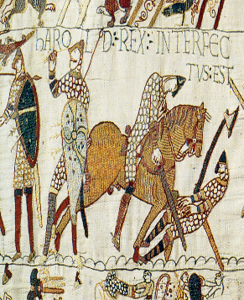
The Battle of Hastings: Tactics
Who was more prepared to win?
King Harold was in York, recoving from the Battle of Stamford Bridge, when he heard about William’s invasion fleet landing in Pevensey. Harold’s armies were exhausted from long marches and the battles with the Vikings.
Harold’s decision:
Harold’s difficult decision as to whether to launch a surprise attack on William or allow his soldiers to rest was soon decided for him. Harold heard news that William and his Norman forces were attacking villages on the south coast and were making their way to London. So Harold left immediately and marches his tired army south to confront the invading Normans.
What do I need to know:
The events and outcomes of the Battle.
The strategy and luck on both sides
The location of the Battle.
Key Words:
Conroi
desertion
Demoralised
Feigned retreat
gonfanon
Senlac Hill
Factors that influences the outcome of the Battle?
Harold’s Mistakes | Williams leadership and tactics
King Harold hurried to face William: he could have waited for between 20-30,00 extra troops from the South-West, but he chose to go straight to Hastings. Harold fought alongside the Normans in 1064, and was aware of their tactics but still used the old Anglo-Saxon techniques of the shield wall. Harold chose to fight on foot rather than horseback, so it was difficult for him to communication with his troops or give orders in the battle. | Both William and Hardrada decided to invade at the same time. The weather delayed William’s invasion this gave him the benefit as Harold had defeated the Viking before he arrived. William chose to delay his invasion, this demoralised Harold’s soldiers. The double invasion occurred during harvest season, which led to desertions (people running away) from the fryd. William gained a Papal Banner so his soldiers believed they had God’s blessing to figth and if they died, they went to heaven. This boosted morale. William chose the site of the Battleground. William took his time invading, he ensured that the had made all the preparations necessary. William’s troops were highly organised into divisions with a system of communication. William was on horseback so had more control of his troops and could be more responsive.
To Summarise!
Both William and Harold made extensive preparations for war and both assembled large armies and navies.
The Battle of Stamford Bridge was a convincing victory for Harold but Harold’s army arrived at Hastings exhausted.
The Battle of Hastings was a very closely fought encounter.
The Normans used archers and cavalry, while the English relied on foot soldiers and hand-to-hand fighting.
William won the Battle of Hastings due to a combination of superior tactics, better leadership, the flexibility and discipline of his troops as well as a little luck.
By winning the battle, William cleared the path to become King, but he had much more work to do to fully secure the English kingdom as his own.
Norman Warfare
The Normans used a variety of tactics in order to win battles. Knights on horseback, called cavalry, were trained from the age of 3, and the horses were trained to kick and bite. Archers were also used frequently. The army was divided into divisions, and flags called gonfanon were used to signal manoeuvres on the battlefield. The Norman army was made up of professional soldiers who spent many hours practicing.

Slide 8
The Battle of Hastings: Events
1
2
3
4
5
Key Words:
Conroi
desertion
Demoralised
Feigned retreat
gonfanon
Senlac Hill
The battle started a 9.oo am.
The archers walked up to Senlac Hill and fired a volley of arrows.
Some of the Norman infantry charged up the hill but were blocked by the housecarls.
The Anglo-Saxons’ main form of defence was the shield wall.
Housecarls overlapped their circular shields and this was a very effective way of defending their position.
4pm:
By this time the Anglo-Saxon shield wall was beginning to disintegrate and the Normans began to attack and break through the sides of the wall. The remaining housecarls fell into a defensive position around Harold. It was at this time that King Harold was killed. Seeing his death, the fyrd broke ranks and fled.
After the first Norman attack failed, a section of the Norman army ran away from the Norman line.
Members of the Fyrd ran after them but became stuck in the marshy land at the bottom of Senlac hill. The Normans turned and slaughtered the Anglo-Saxons who chased them. This tactic became known as the feigned retreat it slowly drained the shield wall of Anglo-Saxons.
Midday: There was a break in the fighting to allow both sides to remove their dead and wounded.
William changed his tactics and moved his archers from the front of the battlefield to behind the infantry. The change in position of the archers meant that, rather than flying over the heads of the horsecars, their arrows hit the Anglo-Saxon army squarely and caught them by surprise.
William ordered his cavalry to charge which led to heavy casualties on both sides. Harold’s troops managed to stay in formation but the Normans deployed their feigned retreat again. Both sides suffered heavy losses and William ordered his knights to dismount and attack on foot. At the same time his archers fired their arrows and the knights and infantry charged at the Anglo-Saxons.
How secure was William
as King of England?
William won the Battle of Hastings on the 14th October 1066.
However, he was not in control of the rest of England.
The country was full of angry Anglo-Saxons, many of whom were still loyal to the King William had just killed.
Two powerful Anglo-Saxon earls, Edwin and Morcar, had not been at Hastings, and there were still significant English forces ready to oppose William.
25th December 1066: William is crowned King of England.

Slide 9
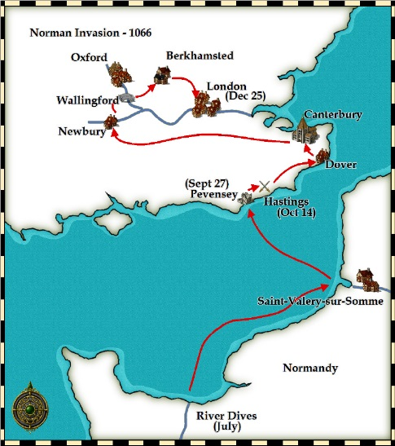
How did William seize control after Hastings?
Key Words:
Earl
Exiled
Housecarl
Inherit
minting
Year | Event | What happened
14th October 1066 | Battle of Hastings | The English infantry was broken, William had won the battle. He gave thanks for victory by founding an altar and later an abbey at the place known afterwards as Battle.
October 1066 | William took the treasury | Following the defeat of Harold at the Battle of Hastings, William made it his first priority to gain control of the English treasury.
Late October / Early November 1066 | William took London | William mounted a campaign of devastation in and around London which forced Edgar Atheling to surrender.
25th December 1066 | Coronation of William | William, Duke of Normandy, was crowned King of England in Westminster Abbey.
1066 onwards | The feudal system | All land belonged to the crown. One quarter was treated by William as personal property and the rest was leased out under strict conditions.
1067 | Distribution of land | William distributed land to his trusted Norman barons. He was careful to ensure that no one man was given too great an area in any given region. The estates were also scattered all over the country to easily put down any sign of rebellion against Norman rule.
1070 | Taxation | Tithes were introduced. Under this system, the population had to pay one-tenth of their annual increases in profit for the upkeep of the church.
1070 | William refused to allow the church power | Although William was very religious, he refused to allow church authority to be greater than his own.
William won the Battle of Hastings on the 14th October 1066.
The country was full of angry Anglo-Saxons, many of whom were still loyal to the King William had just killed.
Two powerful Anglo-Saxon earls, Edwin and Morcar, had not been at Hastings, and there were still significant English forces ready to oppose William.
25th December 1066: William is crowned King of England.
William Crowned King of England
William met little resistance as he moved around southern England. But his army was repulsed to the south of London as he tried to enter it. William had to march around the city looking for suitable river crossing points. As he did so he laid waste to the land depriving the Londoners with supplies. William crossed the Thames at Wallingford and at Berkhamsted he was met by a peace delegation including Edgar the Aetheling, Aldred of York, Wulfstan bishop of Worcester, Walter bishop of Hereford several other high ranking Earls who accepted William as their new King. William the Conqueror was crowned King of England on December 25th 1066, Christmas Day, at Westminster Abbey in London. William's control of England was not complete. In the following years he had to deal with several uprisings against him.

Slide 10
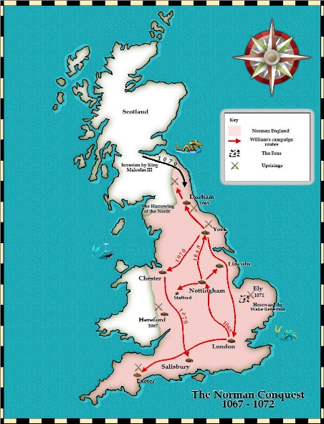
Revolts 1067-1075!
What do I need to know:
Who William’s opponents are.
They key rebellions.
The ways William dealt with rebellions.
1067 Hereford | 1068 Exeter | 1068 Mercia | 1068 York | 1069 South West | 1072 Scotland | 1075 Revolt of Earls
Trouble broke out in Herefordshire when Edric the Wild started a revolt with a number of English followers. Edric was supported by the Welsh princes and managed to steal property along the Herefordshire / Welsh border. Outcome: Edric failed to take control of the area | The city of Exeter rebelled against William’s rule. William took back control by besieging the city, Exeter held out for 18 days and then were forced to surrender to the King. Outcome: The King built a castle on the highest ground and left his half brother Robert of Mortain in charge. | Edwin and Morcar provided a challenge to William’s rule. The two earls began to gather allies against William and in Edwin’s land in Mercia. Outcome: William acted as quickly as soon as he realised there was danger. He led an army swiftly northwards, stopping in Mercia ensuring no revolts and then to Northumbria, building castles along the way. | Edgar needed allies in order to continue his pursuit of King of England, he flees to the North. Edgar attacked York and the North of England became the most rebellious area of England. Danish Vikings joined forces with Edgar and Waltheof. The joint English and Danish army defeated the Norman forces and captured the castle in York. Outcome: William decided to deal with the attack in York himself, and marched North, as he approached the Vikings retreated and William paid them to leave. | William is once again under attack from King Harold’s sons, who landed in Exeter in the South West and attacked it. Outcome: The Norman soldiers placed at the castle after previous unrest, defeats them and forces them to return to Ireland. | Scotland invades northern England in 1070 led by King Malcom III of Scotland. Outcome: William assembled his troops and marched on Scotland and by 1072 King Malcom III was forced to sign the Treaty of Abernethy, this meant that he accepted William as his overlord and exiled Edgar. | William faced rebellion from his own Norman earls. Ralph de Gael and Roger de Breteuil had support from a variety of people, this included King Philip of France who did want William to become too powerful. This was a serious threat to William. However, William did not deal with the threat himself, he left it to his trusted regents, Lanfranc and Odo. Outcome: During Christmas of this year, William had the rebels blindfolded and murdered, Earl Roger was imprisoned and ralph retreated to Brittany. This was the last serious threat during William’s reign.
Key Words:
Fortifications
Negotiation
Treasury
Siege
Ravaging
Revolts 1067 – 1075
1067 Hereford
1068 Exeter
1068 Mercia
1068 York
1069 York
1069 Harrying
of the North
1069 South West
1069 East Anglia
1072 Scotland
1075 Revolt of
the earls
Timeline of rebellions
25th Dec 1066 | March 1067 | Dec 1067 | 1068 | Jan 1069 | 1070 | 1072 | 1075 | 1076
William is crowned King of England | William returns to Normandy and there is unrest in Herefordshire and Wales | William returns to England. William distributes land in areas of potential rebellion to his loyal barons. | Rebellions in the South West. Siege of Exeter by William. Earls Edwin, Morcar and Edgar flee north. | Rebels burn Norman Earl of Commines to death in Durham. Rebellion in York Vikings invade Revolts in: Dorset, Somerset, Staffordshire and Cheshire. King Malcolm of Scotland marries Edgar’s sister, Margaret. | ‘Harrying of the north.’ Unrest In East Anglia | Scotland invades northern England. | Revolt of the Norman earls | Last English earl, Waltheof killed by beheading. Scottish Raids in Northumbria

Slide 11
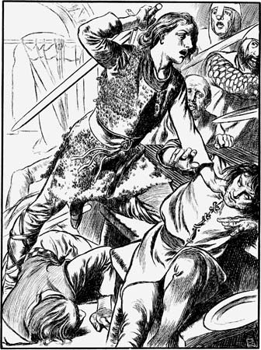
The Harrying of the North and Hereward the Wake!
The North of England was the most rebellious area, as it saw itself as semi-independent from the rest of the country. There was also a large number of people who were of Danish Viking descent who sympathised with their country of origin. To help secure him against rebellion, King William tried to make alliances with the remaining English earls, Edwin, Morcar and Waltheof, however the English earls refused to be ruled by William.
What do I need to know:
Why William punished the North.
What happened in the Harrying of the North.
To explain the importance of the Harrying of the North.
How did William punish the North?
William to punish York and the north laid waste to vast areas of land around York, burning and salting the fields and killing any living creature.
The Domesday Book written in 1086 records that 80% of Yorkshire was known as ‘waste’ which meant it was uncultivated and unpopulated.
Key Words:
Harrying
Hereward
Danelaw
Edwin
Morcar
Salting
Waltheof
Earls Edwin and Morcar:
Fought Hardrada at Fulford Gate
After Hastings they were the most powerful remaining Anglo-Saxon earls.
In 1068 they rebelled against William in Mercia.
Edwin and Morcar provided a challenge to William’s rule.
The two earls began to gather allies against William and in Edwin’s land in Mercia. William acted as quickly as soon as he realised there was danger. He led an army swiftly northwards, stopping in Mercia ensuring no revolts and then to Northumbria, building castles along the way.
In 1068, Edwin and Morcar, with Edgar the Aetheling, fled William’s court, and went north. This began the Harrying of the North.
Edgar and the York Rebellion
1068-1069
Edgar needed allies in order to continue his pursuit of King of England, he flees to the North.
King Malcom of Scotland gave Edgar his support against King William. Malcom had just married Edgar’s sister so was now related to him.
Events spiralled out of control in January 1069 when the Norman Earl Robert of Commines and his men were murdered by English rebels.
Edgar attacked York and the North of England became the most rebellious area of England.
240 Danish Viking ships invaded in the summer of 1069.
They joined forces with Edgar and Waltheof. The joint English and Danish army defeated the Norman forces and captured the castle in York.
William decided to deal with the attack in York himself, and marched North, as he approached the Vikings retreated and William paid them to leave.
1068 South West
William is once again under attack from King Harold’s sons, who landed in Exeter in the South West and attacked it. The Norman soldiers placed at the castle after previous unrest, defeats them and forces them to return to Ireland.
1069 East Anglia
Why did Hereward the Wake rebel?
After Harrying the North, the English earls Edwin and Morcar continued to cause problems for William in East Anglia.
They joined forces with King Swegn of Denmark and Hereward the Wake, an English thegn (a person who owned land).
Hereward had a grudge against William and wanted to dethrone him, the attackers used guerilla style tactics in the marshes in East Anglia.
They set up a base on the Isle of Ely, where they built up supplies to survive a siege. William was not able to use his usual tactics, so had to develop a new attacking method – siege towers.
The events at Ely did not all go William’s way, however in the end the Monks helped William find a secret rout to Hereward and he disappeared and the rebels surrender to the Normans.

Slide 12
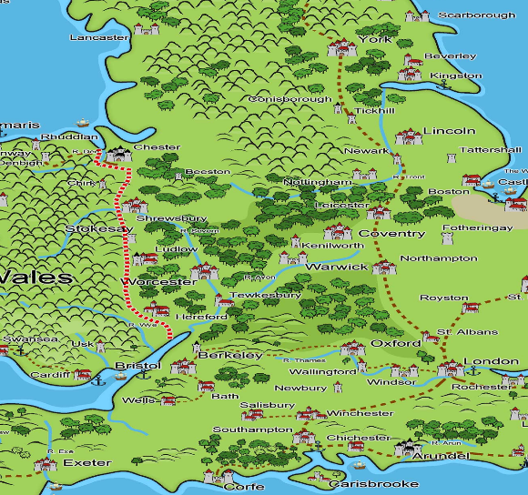
Method of Control: Castles
What do I need to know:
Why William built castles.
Where castles were built?
How castle building changed.
About Pevensey castle.
Key Words:
Crenellations
Fort
Pevensey
Ramparts
Why was William a Castle Builder?
William defeated Harold Godwinson in the Battle of Hastings
Between 1066 and 1086 the Normans built around 500 motte and bailey castles
These castles were part of William’s long term strategy to secure his position on the throne of England
As soon as William landed in England to attack Harold he rebuilt a castle in Pevensey
Defeated Anglo Saxons did not want William as their leader
Normans built castles as bases for offensive patrols in different areas in England – to protect Normans from further attack
The first castles – Motte and Bailey
The Normans needed to build their castles quickly – sometimes in just a few days so at first they used earth and wood which were easily available and quick to use. Using this method they could build Motte and Bailey castles in 2 weeks.
The first castle – Pevensey Castle
What was the purpose of castles?
Norman castles were built for defense against invaders and to control the Anglo – Saxons
Norman castles were primarily built by nobility
Castles symbolised Norman suppression of Anglo Saxons
Norman castles were large imposing buildings built to intimidate, bully and to administrate the local area
Norman castles were a visible distinction between the rulers and the ruled
Motte and Bailey castles were easy to build and made use of geographical features, such as hills
Wooden motte and bailey castles were built until 1070
After 1070, stone keeps were added and by 1100 all new castles were made from stone
Pevensey was the first Norman castle
It was typical of castles during Norman England
Was originally created as a temporary shelter for William and his nobles, to use as a base to launch their invasion of England
Pevensey was seen as the gateway to Britain as it was a coastal location
Already there were stone remains of a Roman fort
William used these to build his motte and bailey castle and he incorporated the Roman remains into the castle
Pevensey developed as an important castle site during the Norman period and beyond
Where were Castles built?
Castles were built at sites that were strategically important
William personally ordered the building of a number of castles
Castles were often built near an existing town, on high ground, close to a water source
Often land had to be cleared to build houses within the castle grounds
The location of castles was extremely important as they had to be high enough to see attackers coming and defend important routes

Slide 13
Unit 2

Slide 14
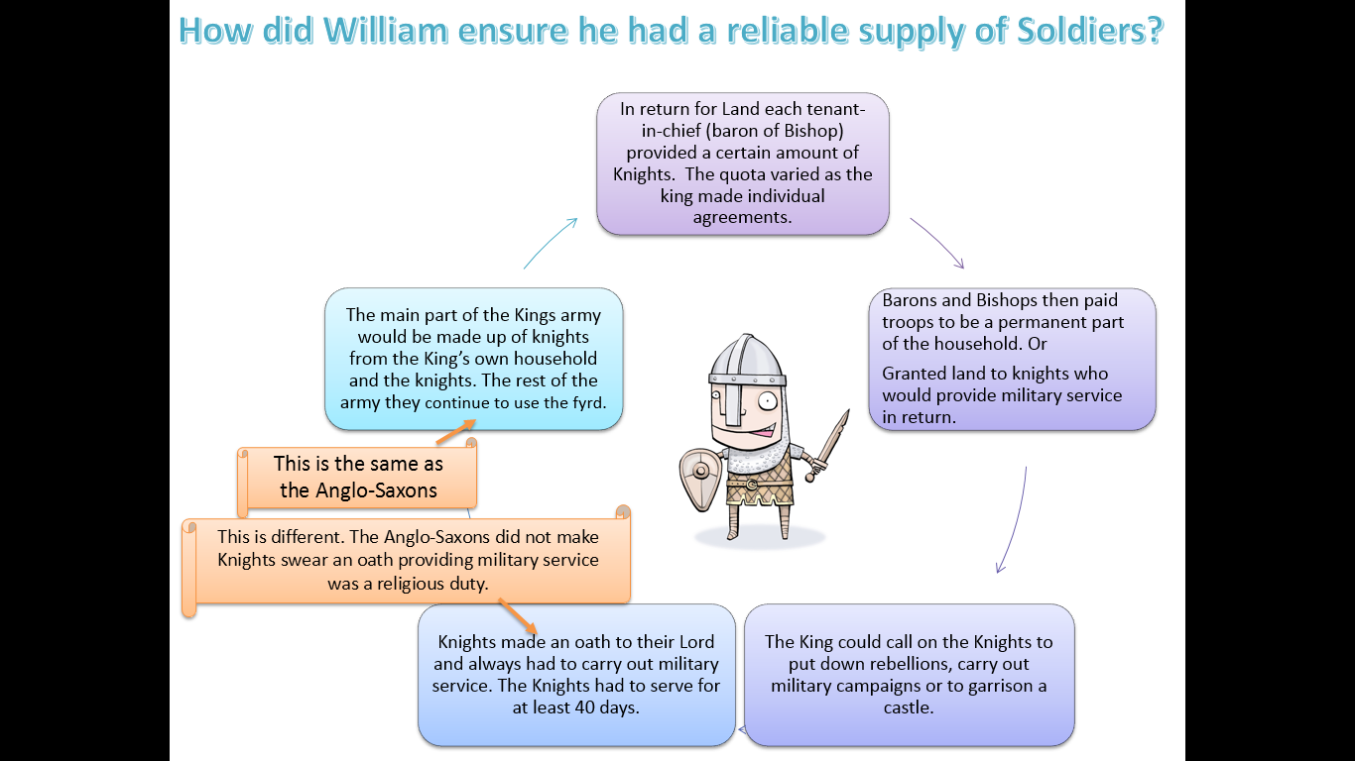
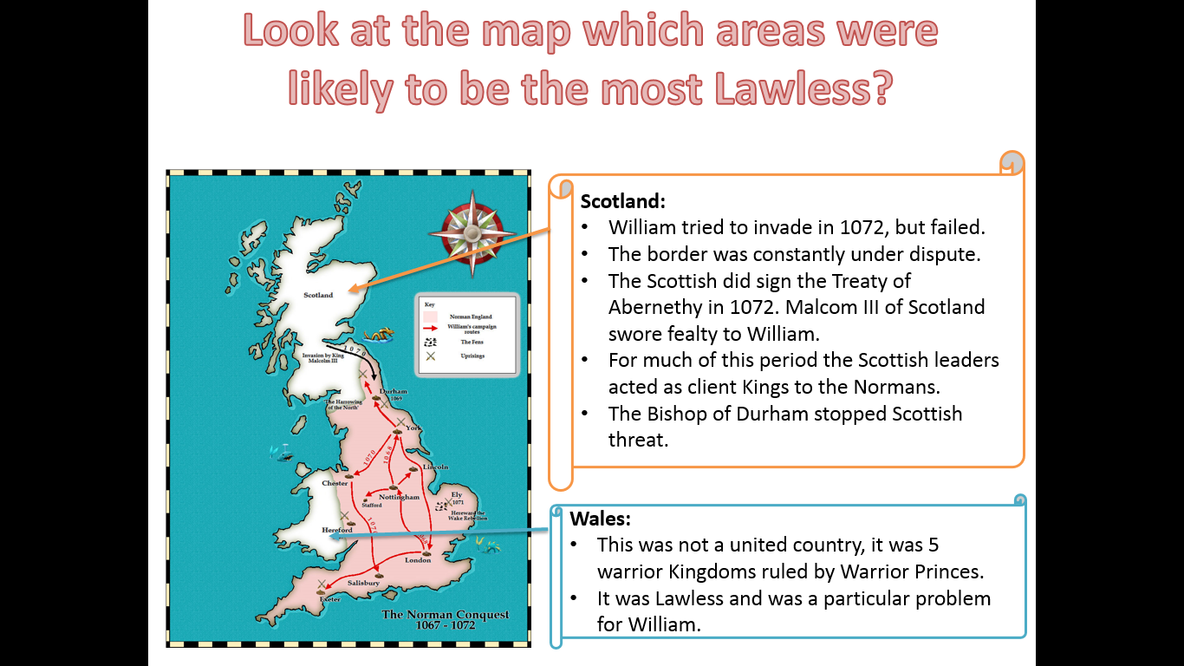
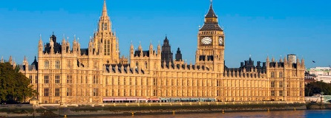
National and Local Government
What do I need to know:
How William used the military to control.
A definition of Patronge.
What a Writ is.
The role of the King.
Key Words:
Patronage
Shire reeve
Sheriff
Writ
Before the Conquest, England’s national government was quite effective. The King was in charge but the nobility were involved in the process of decision making through the witan ensuring their loyalty. The Norman Kings continued to listen to the advice of their leading subjects through the Great Council.
The role of the King!
The king had the power to:
The king was the only one who could make laws for the whole kingdom.
He alone could raise taxes on a national level.
Certain more serious legal cases ‘royal pleas.’ were only heard by the King or the King’s court.
What changed and what stayed the same?
Anglo-Saxon | Normans
King Edward the most powerful person in Anglo Saxon country The King governed the country, created new laws, controlled the production of money, owned and granted land, had the ability to raise an army and decide taxes The Witan was a council that advised the king on issues of government The land was divided into earldoms; Northumbria, Mercia, East Anglia, Wessex, Kent. There were lots of ways the land was divided up. Burhs were built for the public and maintained by the town for the protection of all, designed to protect Anglo Saxons Most of society was made up of peasant farmers, slaves and thegns (local lords) People had to obey the law, use the king’s coins, pay taxes and complete military service, provide for the army The men of the Anglo Saxon army was called the fyrd Earls were the highest Anglo Saxon aristocracy, the area controlled by an earl was called an earldom, the earl’s power relied on support of the thegns Thegns were those who held their land directly from the king and served him Ceorls did not own the land where they worked but they leased it from the lord and they were independent farmers. Cottars and serfs made up about 80% of the population Religion in Anglo Saxon England was an important part of everyday life, as people believed in heaven and hell. The king was seen as an agent of God, and his conduct and rule had to reflect this | King William declared that all land in England now belonged to him when he was crowned and he was free to grant this land to those who served him well The King governed the country, William enforced the laws much more strictly, the royal seal had an image of William of it and so did the king’s writs (official documents and proclamations) were used to maintain control, oath ceremonies were also held to serve William loyally The land was divided into smaller areas that meant that no one person or family had all of the power Castles were built to establish control over England, they were private for the lord, small and easy to defend and designed to control the people Society was divided under the Norman feudal system, based mainly on landholding, many news laws were brought in Curia Regis, the King’s court. Barons and Tenants in chief were the large landholders of Norman England who held their land directly from the king, they also had a lot of power Knights were called upon when needed, their role was to guard their Lord’s property, ride out to combat any threats and provide up to 40 days service directly to the king. Villeins were those who actually did the farming and the work, but had little power, feudalism tied everyone closer to be dependent on their lord
Patronage!
To encourage loyalty, the king would offer land but could also grant offices such as sheriffdoms.
Those who were not loyal officer could expect to have their land taken off them.
Lords who wanted to have power or land needed to remain loyal.
Government by writ!
In Anglo-saxon times the main instrument of government was to issue an order in writing (called a WRIT!) This was a short document which gave orders to be sent around the country.
The Normans continued this system but offered far more Writs. William wanted a more centralised government.

Slide 15
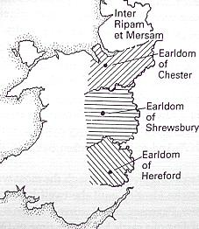
Landholding and Lordship!
What do we mean by Landholding and Lordship?
What do I need to know:
To define the ‘Landholding’ and ‘Lordship’.
To understand how William used this to gain control
To know who the Marcher Lords are.
To understand how landownership changed.
We mean who control and owned the land, how William used the Feudal system to distribute land and how he divided it up between his Lords in Lordships.
For example:
Although William’s distribution of land made lordships more compact the impact of this would have been affected by nobles who then granted out pieces of land to their followers. When there were revolts by nobles William broke up the compact lordships such as with the Earl of Shrewsbury, who controlled most of Shropshire.
William and his barons had more power than their predecessors, but the basic framework of Anglo-Saxon state remained the same.
Wales was not a united country with a single leader but 5 kingdoms each ruled by a warrior prince.
William could not conquer it as he had England.
Lordship!
It was important that the king gave out land to his followers it was given out in much more compact units rather than the old Anglo-Saxon estates which tend to be more widely scattered. William would lump together the lands of small landholders and give them to a single new Norman Lord. This was important because it would have been a big change.
Key Words:
Barons
Bishops
Earldoms
Lords
Patronage
Thanes
How did landholding change?
Wales and the Marcher Lords?
Anglo-Saxon | Normans
They had about 4,000 Thegns. Edward the Confessor granted very large areas of land to his earls. They got too big and powerful. | Landholding became more concentrated. By 1086 only 4 English Thegns still had any land. The King, the Church and 200 Norman Barons and Bishops held the land. William did not let any one person have too much land. Apart from the Marcher Lords- who were a special case. Barons were granted smaller amounts of land- often confined to one county. This made it much harder for them to build a power base from which to challenge the King’s position.
On several occasions William attempted to take over north and west Wales using his army, but he failed. The princes did in theory swear loyalty to him in exchange for his protection. However, they were not very co-operative and the border was an area of attack.
The borders between Wales and England needed to be powerful. Where William feared invasion or rebellion he granted large pieces of land to his most trusted followers.
He granted land to the Earls of:
Shrewsbury
Hereford
Chester
The border area was known as the Marches and so the barons were known as the Marcher Lords.
The role of the Marcher Lords!
The Marcher Lords were almost independent rulers in their areas. They were tasked with preventing any raid by the Welsh. Their extra powers including: Keeping their own armies, building castles without the Kings permission and making laws in their area.

Slide 16
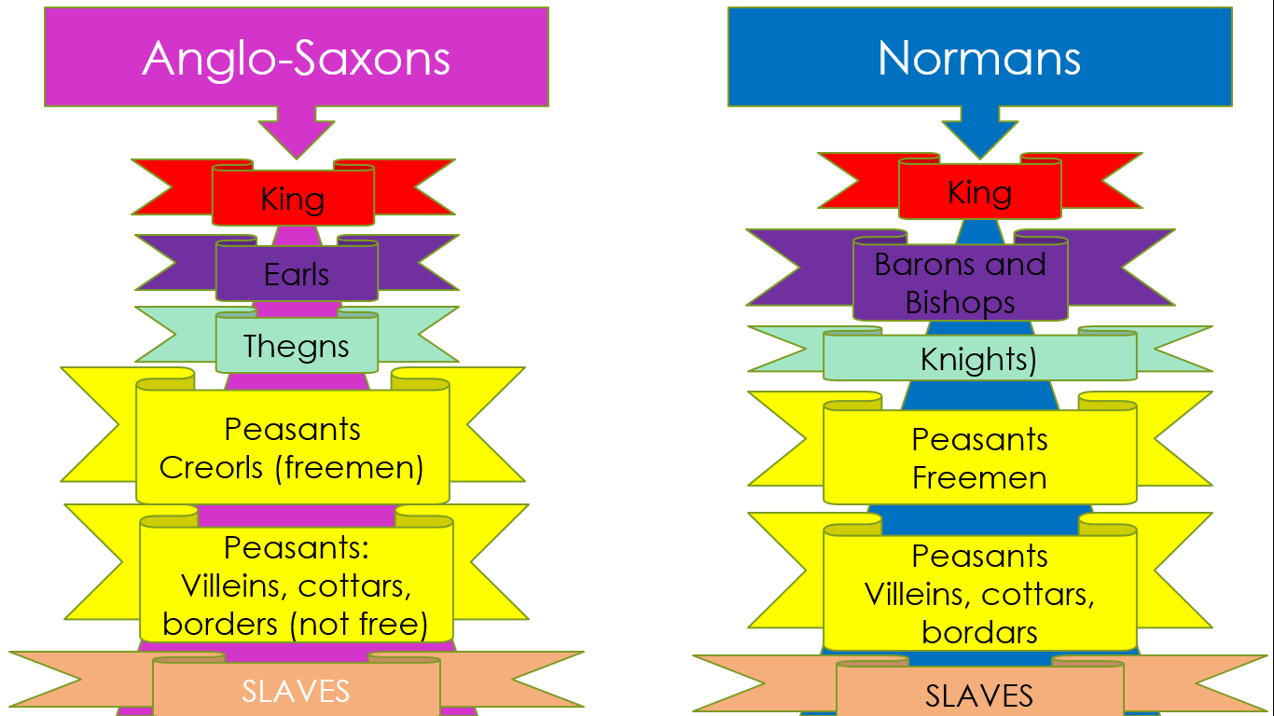
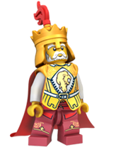
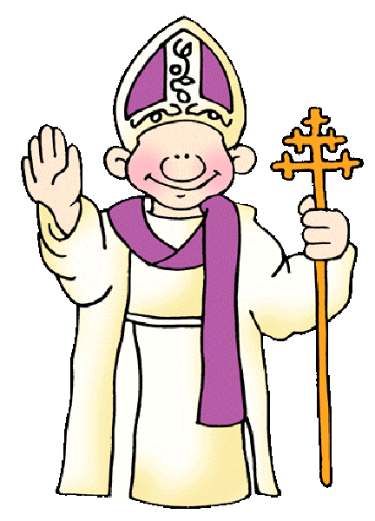
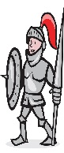
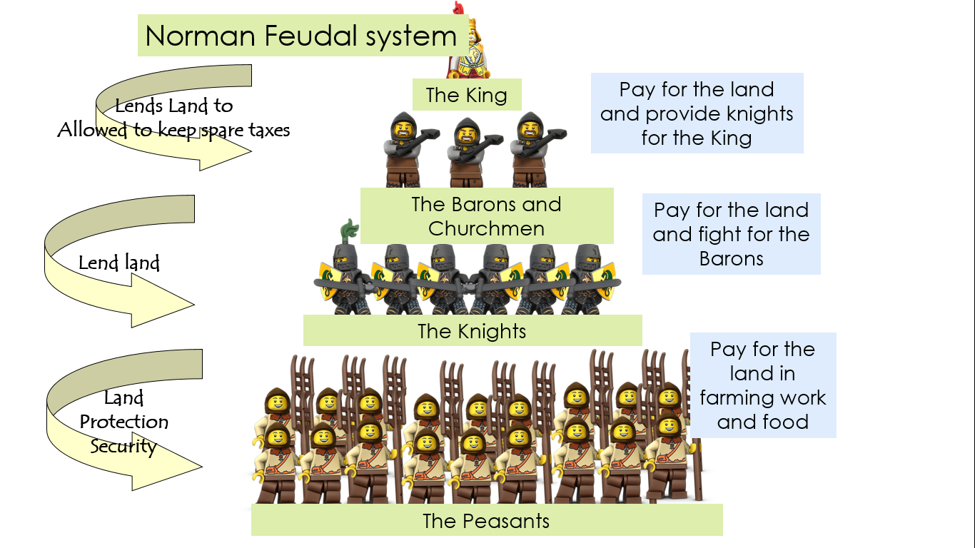
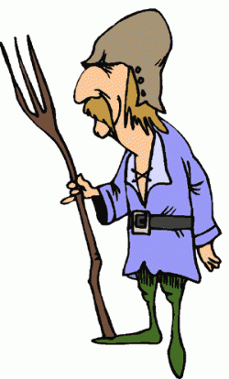
Landholding and Lordship!
How was land controlled by the Anglo-Saxons?
What do I need to know:
To define the ‘Feudal System’
To explain why William tried to retain leading Anglo-Saxons and failed.
To know the roles, rights and responsibilities of government.
Before the Normans arrived in 1066, the English were ruled by the King Edward the Confessor and the Anglo-Saxon-aristrocracy- the earls. England was divided into earldoms (areas of land). The King could make anyone an earl, and given them an earldom, but he could also take land away. He could request troops from earls during times of war and service of their Housecarls and Fyrd if they were to keep the King happy!
The Feudal System was how William used land to ensure loyalty.
King:
William directly owned 20% of the land.
25% was owned by the Church.
The rest was shared out amoangst William’s supported.
200 Bishops and Barons.
What happened to English Landowners?
William wanted to reward mercenaries loyal service with land as well as money.
By 1076 the last English Earl Waltheof had been beheaded.
There were only 2 Englishmen who held land directly from the King: Thurkill of Arden and Colswein of Lincoln.
By 1096 all of the Senoir positions in the Church were held by Normans.
Anglo-Saxons lack of loyalty meat that they were replaced by Normans.
William instead used the Feudal system to favour those who had helped him conquer his new Kingdom.
Barons and Bishops:
They were granted land (they did not own it- they held it in tenure)
In return they swore fealty and paid homage to William.
They also promised money and service.
Knights:
Under-tenants
They promised to be loyal to their baron or bishop.
A knight also be called a LORD OF THE MANOR.
They served as knights in the army.
They granted some of their land to the peasant.
It was the organisation of society whereby the higher layers of society gave land to the lower in return for an oath (a promise).
Oath of Fealty:
The Oath of Fealty was an oath of loyalty. IT was a promise to serve the Lord and be faithful. IT was a religious act
William developed the system to his advantage:
Norman Lords replaced Anglo-Saxons.
The King had far more power.
The peasants were more exploited.
The Norman Feudal system was more formal that the Anglo-Saxon system.
For example the Anglo-Saxon kings had raised armies for their tenants as they were needed.
This continued but was more formal with knights guaranteeing a certain number of days service.
The feudal system provided William with an army and made sure the population was kept under control. Loyalty to the King was the first obligation of all noblemen and knights.
Peasants
They had to obey the Lord their manor in return for their land.
They also gave the lord some of their crops and worked a set number of days on his lands without pay.
Most could not leave the Lord’s land without permission- therefore most were not freemen.
Key Words:
Administration
Aristocracy
Earldoms
Feudalism
Lords
Patronage
Social hierarchy
Thanes
Villein
Slaves
They made up 10% of the population in 1086
Rapidly declined as they were expensive to keep and the Church disapproved.

Slide 17
Law and Order
What do I need to know:
The Law courts
Punishments
Trial by ordeal
Law enforcement.
How was the law enforced?
A suspected person was strapped to a chair and thrown into a lake. If they sank they were innocent; if they floated they were guilty, and then they were executed. The accused died in any case, by drowning or execution.
This involved a person putting their arm into a cauldron of building water or holding a red hot iron bar and walking 3 paces. The wound was bandaged and if it started to heal after 3 days the person was innocent; if it did not they were guilty.
This was introduced by the Normans!
NEW! If a nobleman was accused of a crime he would fight his accuser and whoever won the fight was thought to be right. The loser was wrong and was also usually dead by the end of the fight.
This was the system for catching criminals after an offence occurred.
This meant that everyone had a duty to raise the alarm if they saw a crime taking place and everyone who heard the alarm had to help to catch the suspect. If anyone ignored the hue and cry, they would be fined.
Hue and Cry!
The Murdrum Fine!
The Normans also introduced a special system to protect themselves from Anglo-Saxon hostility, the MURDRUM FINE!
If a Norman was killed and their murderer had not been found within 5 days, the hundred (all the local community) would be fined.
These fines helped to reduce violent acts against the Normans but when attacks did occur, the fines provided valuable income for the King.
This was a group of 10-12 freemen.
They promised to prevent each other from committing a crime.
If one of them did, they had to reveal the guilty one or risk the whole group being punished, usually by a fine.
However, many guilty men escaped.
Some sought sanctuary in the church.
Tithing!
Types of Court!
Kings Court | The King was the most important person in the justice system this was the same as under the Anglo-Saxons. His decisions were binding. The King’s court dealt with royal pleas. Crimes: The most serious offences, robbery, rape, arson, treason, murder. The King could also hear appeals from lower courts.
Shire Courts | Anglo Saxon. Not much change They now met regularly and were supervised by a sheriff. The judges were landowners or sheriffs. Crimes: They heard disputes over land or theft or violence.
Hundred Courts | NEW NORMAN IDEA. Also known as the HONOURIAL COURTS. They were for the Lord to deal with his tenants. They supervised property transactions or announced new laws from the King. The tenants gave the Lord advice.
Manor Courts: | Manor Court was the area of land controlled by the Lord of the Manor. Minor court Dealt with day to life e.g. bad ploughing or labour not being supplied.
Most towns had a watchman who tried to make sure that people kept to the CURFEW. They were there to prevent crime and catch criminals.
They were either volunteers or were given the job as a duty.
Many did not take their job seriously and regarded their duty as a chance to drink with friends.
Watchmen
Key Words:
Manorial Court
Hue and Cry
Constables
Tithing
Oaths
Watchmen
Trial by ordeal
Some places had constables to keep an eye on things, but these men only had the job for a year.
They had the power to arrest people, break up fights and prevent fires.
They held the key to the Stocks.
They were not paid much and often had other work to supplement their income.
Constables

Slide 18
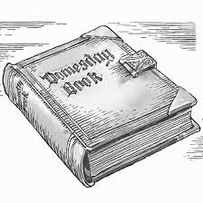
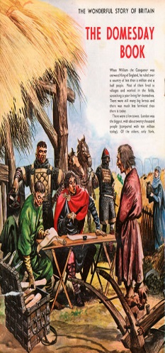
The Domesday Survey and Tax!
How difference was inheritance Law?
What do I need to know:
Why William ordered the survey
Compare life in England in 1066 and 1086
Evaluate the impact of the Normans on landholding.
Understand inheritance laws.
The traditions of inheritance changed under the Normans so that the king had more direct control.
Domesday Survey- how and why William survey the country to keep the money flowing in.
Anglo-Saxon | Normans
Under the Anglo-Saxons, property and land was divided between all the sons. | The Normans changed this and property was passed on intact to the eldest son. This is known as Primogeniture. This meant that the Normans were able to keep large estates of land and maintain power effectively. Primogeniture meant that younger brothers and sisters could be left with nothing after their father’s death. The Lord could then keep the land, grant it away as a gift or sell it off. If a tenant died before their heir was of age, the Lord could take the land temporarily! These laws were known as FEUDAL INCIDENTS and gave a totally new source of money and power for the king and the elite. IT meant the lords had continuing control of how much their tenants lands descended from one generation to another.
The Domesday Survey!
In 1085 William asked officials to conduct a survey of all property and resources in England.
It was a massive undertaking which was completed in less than a year.
The resulting document is one of the best sources we have about Norman England.
The Norman Conquest had completely changed the ownership of land in England. Since 1066 people had died or land had been sold and land disputes were common.
They took up court time and caused unrest. A thorough survey would reveal exactly who owned what and how that had changed since 1066.
Even more importantly it would allow William to change rents and tax people more efficiently.
When it was presented to the King at Salisbury on 1st August 1086, the most important tenants were made to swear loyalty to the King. The final survey as we have it today was completed by William’s son, William Rufus.
What does the survey tell
us about William?
What does Domesday
mean?
When did the survey
become a book?
In 1085, William faced the threat of invasion from Danish Vikings and the Count of Flanders, so he called a Council of War in Gloucester. He needed to enforce a geld (tax) to pay for his army. He ordered an inventory to be drawn up in order to help him raise the tax.
William and his family owned 20% of the land in England.
The Church owned 25% and about 10 members of the Norman aristocracy held a further 25% of land.
The remaining 30 % was heled by 170 people.
The Survey was suggested in 1085 and carried out in 1086. It was only written in a book in the time of William II.
The survey became known as Domesday which means ‘day of judgement’. The term was only used in the 12th century because by then the legal authority of the Survey was seen as being equal to that of God’s on judgement day.
What did the
survey miss out?
What does it tell us
about England?
What does it tell us
about the
population?
What can we learn from the Domesday about differences between Anglo-Saxon and Norman England?
Key Words:
Patronage
Primogeniture
Feudal incidents
Writs
About 250 people controlled the land, this was SIMILAR to the time of Edward the Confessor. However, the main DIFFERENCE was that under King Edward the land belonged mostly to Anglo-Saxons, under William it was mainly owned by foreigners.
It tell us who owned the land but also sheds light on England’s population and how much wealth that population did or did not have.
There were about 2,000 knights and 10,000 Norman settlers. The total population was between 1.5 and 2 million people.
Some places were left out including London and Winchester, perhaps because the survey was left unfinished.
William II abused this system, causing a lot of complaints. Therefore, the coronation charter of Henry I promised that he would act in a just and lawful manner.

Slide 19
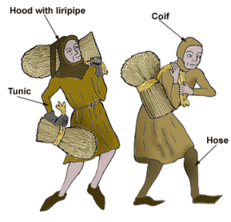
Village Life!
Key Words:
Manor House
Fallow
Mill pond
Manorial Court
Lord of the Manor
Open field system.
Roles and responsibilities
What do I need to know:
To understand the key features of a village.
To know how much changed in a village.
To know the key roles in the village.
90% of people lived in the countryside during this period. There were small clusters of houses with between 100 and several 100 people.
They were controlled by the lord of the manor, who lived in the manor house.
Reeve | Senior officials who worked on behalf of the Crown in local areas, for example, as a chief magistrate. After the Conquest, the reeve’s job was reduced to the day-to-day management of the manor and its peasants, an essential role to ensure the everyone did their jobs. The reeve was a peasant chosen by the Lord or through a vote by the peasants.
Bailiff | In charge of collecting taxes for the crown and ensuring that crops were gathered and debts repaid.
Priest | Ran the local church, he was responsible for ensuring marriages were legal.
Miller | Produced grain to make bread for the area. Bread had to be baked in the ovens of the lord of the manor and the lord decided how much money the miller paid for this.
Classes of Peasants!
97% of the population were peasants.
 | Change | Continuity
Taxes | The Normans increased the rent and taxes and much money raised was spent in Normandy.
Freedom | The Domesday Survey shows the number of freemen declined dramatically as a result of the Conquest. Freemen who could not afford the increased rents had to revert to being villeins-working for the Lord with limited freedom.
Forest Laws | The Normans created game reserves such as the New Forest in Hampshire and rove 500 families from the land. The Forest were Royal and Forest Law banned Anglo-Saxons from hunting in the forests. If they did they faced serious punishment such as being blinded. The rich hated it as they lost out of sport, the poor lots out on a source of food and their crops were damaged.
Law and Order |  | There was no new manorial system imposed on England after the conquest the traditions and organisation stayed the same. Danelaw custom survived in the North and East of England.
Lord of the Manor |  | the relationship of the villein to his land as well as working for the Lord, he could not leave his land and he paid a fine – the ‘merchet’ when his daughter married and ‘heriot’ when he took over the land from his father. The villein could be taxed by his Lord.
Work |  | Ordinary peasants the structure of their village remain the same, they would see the same people doing their jobs around the village – the bailiff, the reeve, the miller, the parish priest. If they were villeins then there may be some free tenants who paid money for their property, and below them would be cottars who had smallholdings of about 2 hectares who worked on the Lord’s land one day a week and provided hired labour.
Were free peasants who paid rent to the lord for their land.
Sometimes they had to carry out BOON WORK (extra days of unpaid work for the lord)
The number of free peasants fell significantly between 1066 and 1086 and many became villeins.
Freemen
Villeins
Worked on the Lord’s land for no pay.
They had no freedom and could not leave the village without permission.
They were granted some land to farm for themselves.
Bordars and Cotars
Poorer villeins and they were given less land by the Lord.
Made up about 10% of the population of 1066.
They had no freedom and no land.
Slavery rapidly declined after the Norman Conquest partly due to a change in attitude but also because it was probably easier to give land in return for labour than it was to support slaves.
Slaves

Slide 20
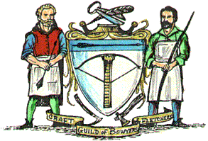
Town Life!
Key Words:
Burgesses
Domesday
Franchise
Guilds
Trade
What do I need to know:
Explain how towns changed under the Normans.
To know the key trades in the towns.
Compare Norman towns and villages.
There had been very few towns in Anglo-Saxon England. But they were very important trading centres. Anglo-Saxon England had a strong trade with mainland Europe and Scandinavia, mainly exporting wool and cloth. Under the Norman control trade increased and the number of towns and size of towns gradually increased. Trade increased because the Norman Lords had greater link with mainland Europe. After the Norman Conquest some existing towns grew in military, religious and administrative centres.
How did trade affect the growth of towns?
Trade played an important role in the growth of towns during the Norman period. Trade links with France were strengthened at the expense of Scandinavians links, however the Normans brought stability in trade and this led to the development of many towns.
By 1086 only 5% of the population lived in towns.
Burgesses:
A Burgess was a town dweller from the upper ranks of townspeople. They owed services and taxes to the Lord and could buy and sell property.
Lincoln had 970 burgesses.
Burgesses had legal and administrative responsibilities but the amount of power they had did vary from town to town.
What evidence is there for the growth of towns?
The evidence can be seen from the Domesday survey of 1086.
London: 10,000 inhabitants.
Winchester: 6,000 inhabitants.
Norwich, York and Lincoln: 4,000-5,000 people.
Between 1066 and 11,000 21 new towns were created!
Many developed as new religious centres with new Cathedrals in Durham, Ely, Salisbury, Winchester and Lincoln.
Salt was very important product as it was used for cooking and to preserve food. The town of Droitwich, fro example, grew rapidly due to the production and sale of salt.
The Domesday Book shows that there were 13 salt houses in Droitwich and that three salt worker paid their tax to the King in Salt.
By how much did life really change?
The Normans did change life in England.
The change was different according to social status.
For those as the very top of the hierarchy when the Normans arrives, THE Norman impact was very significant.
For the peasants life changed very little.
The Salt Trade
The production of iron and lead was very important in Norman England for building houses and making weapons. Towns that specialised in metalworking were often situated near woodland, because wood was used in the furnaces needed to melt and shape metal.
Metalwork
Markets and Fairs!
Markets and Fairs could only be held if a Franchise (authorisation for a group of towns people to carry out business activity) was given in the form of a grant.
After the Norman Conquest 2800 grants were given.
Whilst markets gave traders a place to buy and sell, fair marked religious events and were an occasion to celebrate.
NEW IDEA: GUILDS!
The Normans introduced guilds to England.
A guild is a society merchants which controlled who was allowed to carry out business there. To practice as a merchant you had to be part of the guild.
Craft guilds were introduced it the later Middle Ages and were used to monitor the quality of goods an set prices, wages and conditions for work.
Wool was in great demand in England and neighbouring counties for making clothes.
It was produced in the countryside, but was brought, along major rivers to market in towns such as York and Lincoln.
Wool was often exported abroad to towns such as Flanders in Belgium.
Some English costal towns grew as centres of international trade, including Boston, London and Southampton.
Towns like Bristol grew as a result of trade in wine from Gascony.
The Wool Trade

Slide 21
Unit 3

Slide 22
The Norman’s relationship with the Pope’s
What do I need to know:
The relationship with the Pope.
What the Pope and the King’s quarrelled over.
The key reforms (changes) made by each King.
Key Words:
Abbots, Bishops, celibacy, clergy, excommunication, Papacy, Parish, Hierarchy, Romanesque, Simony, Synods.
The Pope’s authority had no geographical limits. Christians everywhere were supposed to obey him.
 | Under William I 1066-1087 | Under William II (Rufus) 1087-1100 | Under Henry I 1100-1135
Beliefs: | Relations were quite good. He put Normans in positions of influence. Lanfranc ensured the English Church had some independence from Rome. | Not a religious man. His morality was an issue. He had no interest in continuing the reforms of the church. Relations declined. | Had a better relationship with the church but there were still tensions.
Pope’s: | Pope Alexander 1061-1073. Pope Gregory VII 1073-1085 (radical) | Pope Gregory VII- 1073-1085 Pope Urban II- 1075-1122. | Pope Urban II- 1075-1122.
Abuses of the Church | Used a geld (form of tax) to extract money from religious houses. Used religious positions to promote and reward people. | -Continued to use a geld (form of tax) to extract money from religious houses. -Used religious positions to promote and reward people.
Positive relationships | ALEXANDER: Relations between William and Pope Alexander were closer. Alexander had given him a papal banner to carry in the Battle of Hastings. They both wanted to reform the corrupt English church and bring it in line with Europe. William agreed to get rid of simony and enforce clerical celibacy (No sex). William’s main aim was to get rid of untrustworthy Anglo-Saxon Bishops. GREGORY: William did agree to the Peter pence 1 penny from every household was given to the Pope. |  | Henry I promised to end Rufus’s policy of plundering the Church and began to fill vacancies straight away.
Controversy | ALEXANDER: Ordered William to do penance for all the blood split at Hastings. William built Battle Abbey finished by 1095. GREGORY: Pope Gregory though the church had more authority than Kings. He wanted direct control over discipline and teaching. Relations with William start to decline. Gregory wanted all English bishops to travel regularly to Rome to report to him. This did not happen. The Pope demanded William swear fealty to him but William refused. | GREGORY: In 1078 Gregory banned Kings from appointing bishops and abbots in order to keep the Church independent. This led to a struggle between him and Kings in Europe over who could appoint senior clergy. Rufus quarrelled with Gregory over this. POPE URBAN: His successor Pope Urban II agreed not to interfere in English appointments while Rufus was king. But their relationship was hostile. | INVESTITURE CONTROVERSY: This was the practice of Kings (lay rulers) giving emblems of their office (the ring and the staff) to new bishops when they were consecrated. This implied the bishop depended on the King for their spiritual power not the Pope. The Church were opposed to this. The problem was many Bishops were also the Kings Tenants-in-chief and owed him dealty. Archbishop Anselm refused to pay Homage to Henry I in 1103 and was exiled. Henry I was threatened with EXCOMMUNICATION and reached an agreement in 1107. The Bishops could pay homage before they were consecrated.

Slide 23
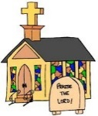
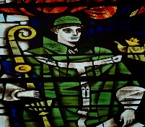
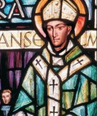
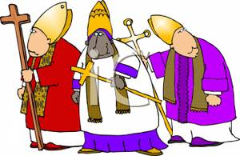
The Norman’s and the Archbishops!
What do I need to know:
Who Lanfranc was?
What reforms Lanfranc made to the church.
Who Anselm was?
Key Words:
Corrupt, diocese, Benedictine, celibate, clergy, corrupt, reform, Romanesque.
In William’s reign a number of changes were made to the way the church was run.
Some changes were:
-to bring the English Church more in line with the rule of Rome
-to enable the Church to run the country
To benefit William himself.
Archbishop Lanfranc with his authority established, Lanfranc started his reforms. Most were brought in 1070-1076.
Pope
Deans
Parish Priests
Archbishops
Bishops
Archdeacons
Archbishop Lanfranc (1010-1089)
Early in his career he was an Italian Benedictine monk and abbot of Bec Abbey.
1066: He went to Rome to obtain a papal banner for William before the invasion.
He advised the King on religious affairs, and played an important role in King William’s reforms of the Church in Normandy, England.
1070: Appointed Archbishop of Canterbury. Started his reform program.
1075: Helped to stop the attempted rebellion by the earls of Norfolk and Hereford.
1087: Helped to secure the throne for William Rufus when William I died.
1089: Died
Area | LANFRANC’S Reform
A new Church Hierarchy: | A more centralised system was put in place. Each level was answerable to the one above. It gave the Bishops greater control over their dioceses. There were 2 new appointments: archdeacons and deans. Archdeacons: all bishops had to appoint archdeacons. They often cover the same land as the shires. Deaneries: came later and they had the same boundary as the 100s.
Bishops | Anglo-Saxon bishops and archbishops were removed and replaced with the Normans. Archbishop Stignand was replaced by LANFRANC. By 1870- there was only 1 Anglo-Saxon bishop left.
Parish Priests | Most Anglo-Saxon priests remained in their job. They were poorly educated. Marriage was banned for priests. The number of village churches between 1070 and 1170 doubled. Over 2,000 had a village church in the Domesday Survey.
Architecture | 1/3 of the Bishops after the invasion were made to move to towns and cities. Leofric moved from Crediton to Exeter. The Normans stole the treasure of 49 English monasteries and took Church land. They began rebuilding Cathedrals and Churches n the Romanesque style. New Cathedrals were built in Rochester, Durham, Norwich, Bath, Winchester and Gloucester. Romanesque: style favours clean lines, with simple yet impressive design.
Synods: | These are ecclesiastical (church) councils. They helped spread the message of reform. Bishops were ordered to hold their own councils twice a year to improve their authority over their diocese.
Legal Issues | 1076, the Council of Winchester ordered that only Church courts could try the clergy, meaning that people who worked for the Church would be tried for their crimes in Church courts. William adhered to Papal law by re-introducing a tax of one pence for every household. When Bishop Odo was arrested in 1082 for trying to take knights to the continent William insisted on him being tried in the king’s court.
Archbishop Anselm.
(1033-1103)
1093: summoned to England to be Archbishop of Canterbury
Anselm had many argument with King William II and King Henry I about their abuses of the Church.
He proposed Church reforms based on those instigated by Pope Gregory in Europe between 1050 and 1080. They were designed to deal with the morality and independence of the clergy.
1095: Rufus stopped Anselm travelling to Rome to get Papal approval for his appointment to archbishop.
1097: Anselm and William II argued over a campaign in Wales. Anselm fled to Pope Urban II in Rome.
He was banished on 2 occasions and went to Rome to support the Church.
1103: he was exiled int eh reign of Henry I for refusing to pay homage to the King.
He remained archbishop until he died and always put the church first.

Slide 24
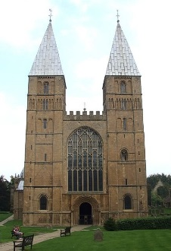
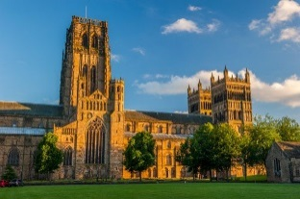
Normans: How did William change Church Buildings?
What do I need to know:
The significance of Norman Cathedrals
The Romanesque design of churches.
The impact of these buildings.
Romanesque Architecture:
This style was favoured by the Normans
It combined Roman style and Byzantium buildings.
The buildings were high quality
They had thick walls, round decorative arches and large towers.
Building had symmetrical patterns, simple with little decoration.
Southwell Minister is a good example of a Romanesque abbey.
Lincoln and Durham Cathedrals were similar to this.
Key Words:
Buffer Zone, benefactor, quire, perpendicular style, shrine, nave
How did William change church buildings?
Major building programme.
By the early 1100s every major Anglo-Saxon cathedral and abbey apart from Westminister Abbey had been knocked down and rebuilt in a Romanesque style.
Many wooden parish churches were rebuilt in stone.
England was a wealthy country and this allowed the Normans to rebuild on a huge scale.
They used forced labour.
Why did they change Cathedrals?
To shows that God favoured the new regime.
The impressive churches were a display of Norman power and prestige.
Where were Cathedrals built?
Winchester, Ely, London, Bury St Edmunds, Norwich were far larger than anything built by the Anglo-Saxons.
Ely had been a wealthy Benedictine monastery. But Ely was the centre of the Hereward the Wake rebellion and was an island virtually cut off.
After crushing the rebellion William put a Norman Abbot Simeon in charge and rebuilt a grand new church in the Romanesque style.
In 1083 work started on the Cathedral but it was a slow process.
Durham Cathedral
Durham was politically important
It was the main English town within the buffer zone along the border with Scotland.
Earls found it difficulty to control the area
The Norman Kings gave the Bishop of Durham additional secular powers (this meant he had legal powers outside of the Church)
This is because people were likely to obey the church
From 1075 , the bishop became a prince bishop.

Slide 25
Normans: Monasticism and Language
What is a monastery?
A religious house where monks live and work. They were known as nunneries, abbeys or priories. Monks and nun promised to devote their whole lives to God and withdraw from society. Many monasteries belonged to the Benedictine Monks in Anglo-Saxons times.
What else did monasteries do?
Spiritual duties
Grew their own food
Building work
Look after animals /land
Worked in kitchens
Farming
Infirmary (hospital)
Almoner looked after poor
Accommodation for pilgrims
Centres of scholarship and learning
Scribe out the bible and manuscripts and libraries
Vows:
They took vows of poverty chastity and obedience.
The Benedictine monks also promised to carry out Manuel labour whilst the Cluniac’s devoted their whole lives to prayer and learning.
What do I need to know:
Monastic Life
The reason for and impact of Norman reforms
Developments in school and education.
What changes (reforms) did the Normans make?
Buildings | The number of monks and nuns increased from 1,000 to between 4,000 and 5,000. They built new monasteries, which went from 60 to 250. They had Cathedrals with monasteries attached to them fro example: Canterbury and Winchester. By 1135- 10 of England’s Cathedrals had monasteries attached. William built monasteries to commemorate his victory and as a penance for the deaths, for example Battle Abbey.
Leadership | The Normans changed the leaders of the monasteries from Anglo-Saxon to Norman Abbots. In 1070 only two Anglo Saxon abbots were removed in Canterbury. When Lanfranc held a council in London in 1075: 13 of 21 were Anglo-Saxon, by 1086 only 3 Anglo-Saxon remained. He defined the role of an abbot and set up a clear hierarchy.
Lifestyle and rules | Lanfranc made domestic reforms Regulating monks’s lives more strictly would mean that the monks were seen to be more pious and the Church would be more respected. Some monasteries were already following the Benedictine rules other had a huge change to adopt strict Benedictine rule.
Lanfranc’s Reforms: | He introduced a set of CONSTITUTIONS at Christchurch Canterbury in 1077. He intended these reforms to spread and improve monastic life. He reformed the LITURGY (words of the service) making it more like the rest of Europe. He introduced uniform practice and made monasteries more in line with the rest of Europe.
Anglo Saxon Monasteries
Many clergy worried about the secular influence in monasteries. A Benedictine monastery needed land as they were supposed to grow their own food and so they would be granted it from a local lord in return for influence. They would control who became abbot and would take money leaving the abbey in poverty. Benedictine monks made vows of: obedience, chastity, poverty and manuel labour. But many were no longer strictly vegetarian, they wore rich clothing and ignored rules about fasting.
Cluniac Monasteries:
These were a strict form of Monastery brought by the Normans.
The firs Cluniac Priory was founded in 1077 by William de Warenne in Sussex.
More were established for example in Thetford.
By 1135 there 24 Cluniac monasteries
They built castles aiming to demonstrate the power of Normans and God’s blessing on it and they answered only to the Cluny Abbot not a Lord.
They lived by very strict laws getting up at 2am to a service called Matins.
Key Words:
Benedictine -Vows
Cluniac
Lanfranc
Reforms

Slide 26
Normans: Language and Education
What do I need to know:
Developments in school and education.
Grammar schools
University education
Latin/Anglo-French Language.
How did education develop?
The key reformers of education were Archbishops Lanfranc and Anselm.
Lanfranc had created new schools in Normandy in 1042 and had later taught theology at a monastery.
They both promoted education and built libraries.
They argued that one function of Church schools was to produce to priests.
A number of grammar schools were built in Northampton, Lincoln and Oxford for this purpose.
Key Words:
Grammar schools, Lanfranc, Latin, rhetoric, Vernacular,
Education: What changed and what stayed the same?
 | Anglo-Saxon | Norman
Location | Monasteries and churches provided education | Churches/monasteries and Cathedrals 1832- Towns and Secular education came in. Grammar schools developed. University.
Who? | Education had to be paid for so only the rich, although a few schools did teach local peasant boys. They worked as servants in the monastery in return for education. Girls were NOT educated. | People lived and worked in towns and needed better literacy and numeracy skills to conduct trade. Norman Barons and Knights wanted their children to be educated to the highest standard possible.
Number of Schools |  | By 1100 all cathedrals and many larger churches had schools. There was an explosion in the number of schools: 12th Century: 40 schools. 13TH Century: 75 schools.
Subjects Taught | Very narrow in terms of who received it and what they wre taught. | Church Schools taught: Latin, music and verse, astronomy and mathematics and law. Secular Grammar Schools: had a broader education.
Language | Latin for writing. Anglo-Saxon English for speaking and lessons. | French language was used although the English language did influence this. Latin was still used for writing and was still the language of Christianity.
What happened in grammar schools?
What age did you go? 10
Where: taught in towns.
How long: 4 years of education.
What did they learn: Latin in detail, how to write it and also grammar.
Equipment: Notes on stone boards.
School Year: September, 3 terms ending in June for harvest in July and August.
Length of day: Sunrise to late afternoon.
Teachers would sit in the middle of the room with pupils on benches around them.

